Slide 1
Summary root finding algorithms

Slide 2
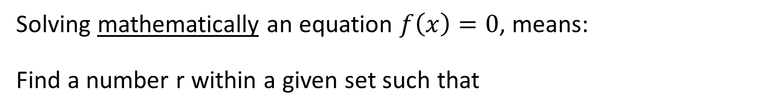
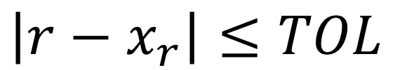
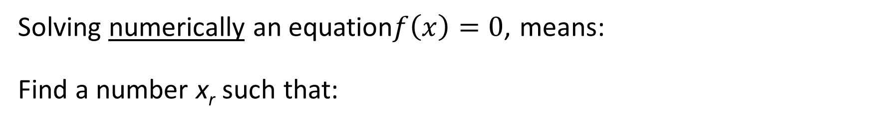
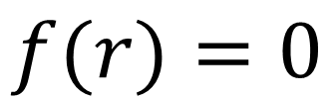
Solving mathematically an equation $f\left(x\right)=0$, means: Find a number r within a given set such that
$$f(r)=0$$
This number r will be referred as the true solution of the equation.
Solving numerically an equation$f\left(x\right)=0$, means: Find a number x_{r} such that:
$$\left|r−x_{r}\right|≤TOL$$
This number x_{r} will be referred as the approximated solution or numerical solution of the equation.
Notes:
We started this this lesson on solving equations by realizing that there is a fundamental difference between solving mathematically in an exact way an equation and solving it numerically.
We learned that no algorithm can give an exact solution r but only an approximation xr. This is in itself not an issue as in engineering we are not so much interested in an infinitely exact solution but in an approximation with an error below a fixed tolerance

Slide 3





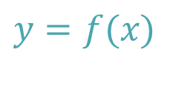
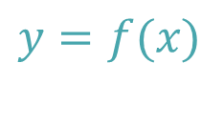

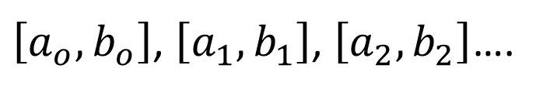



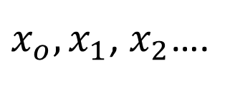
Two families of algorithms
Bracketing methods
Open methods
$$y$$
$$y$$
$$y=f(x)$$
$$y=f(x)$$
$$a_{i}$$
[
]
$$r$$
$$x$$
$$r$$
$$x_{i}$$
$$x$$
$$b_{i}$$
$\left[a_{o},b_{o}\right]$, $\left[a_{1},b_{1}\right]$, $\left[a_{2},b_{2}\right]$….
$x_{o},x_{1}$, $x_{2}$….
Notes:
We discussed two families of algorithms:
Bracketing methods which produce a succession of intervals becoming smaller and smaller containing the root r
And open methods which produce a series of numbers xi which, if all conditions are met, will converge to the root r.
All methods will need some initial guess to start them.
For bracketing methods you will have to provide an initial interval [ao, bo] containing the root and open methods will require an initial guess xo to start them.
The algorithms do not give any methodology to find these initial guesses.
You have to find then based on a graph, educated guess, trial and error or any other suitable method.

Slide 4






Bracketing methods
Bisection method
False-Position method
$$y$$
$$y$$
$$y=f(x)$$
$$y=f(x)$$
$$a_{i}$$
$$x_{c}$$
[
]
[
]
$$r$$
$$x$$
$$r$$
$$x$$
$$a_{i}$$
$$b_{i}$$
$$b_{i}$$
[
]
[
]
$$a_{i+1}$$
$$b_{i+1}$$
$$a_{i+1}$$
$$b_{i+1}$$
Notes:
In the family of bracketing methods we saw two examples: the bisection and the secant algorithm
Their difference is in the way they cut the interval [ai, bi] to form a new, smaller, interval [ai+1, bi+1]
The bisection algorithm simply cuts into two the interval whereas the secant method uses the intercept with the x-axis of the line passing by (a, f(a)) and (b, f(b))

Slide 5
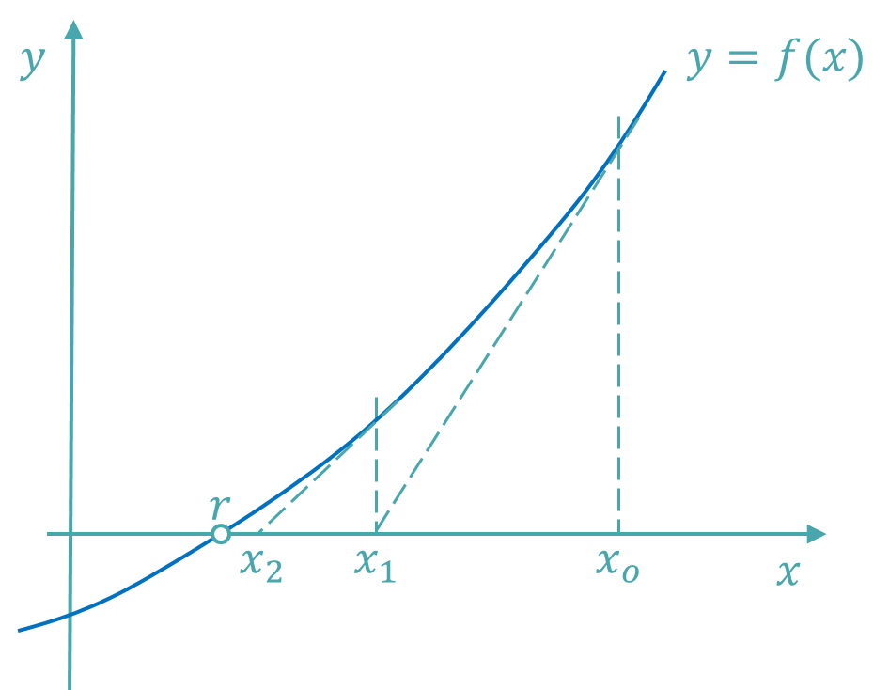






Open methods
Fixed point method
Newton method
$$y$$
$$y=x$$
$$y=g(x)$$
$$r$$
$$x_{o}$$
$$x$$
Notes:
In the family of open methods we saw as well two example: the fixed point method and the newton algorithm
Their approach is very different.
The first one iterates over the equation xi+1=g(xi), whereas Newton’s method take advantage of liner extrapolation to provide successive improved approximations.
Pay attention as well to the difference between the formulation of the original root finding problem.
The fix point method requires the equation to be written in the form of g(x)=x
Newton’s method uses the traditional format f(x)=0.
Both method are not necessarily converging.

Slide 6
Comparing the speed of convergence of algorithms
High Error
Error $E_{i}$
Algorithm 1
Low Error
Algorithm 2
Number of iterations $i$
Notes:
We learned that different algorithms will converge more or less quickly to the desired root.
A plot showing the error $E_{i}$ of the approximation $x_{i}$ in function of the number $i$ of the iteration allows to compare algorithms in term of speed
How fast an algorithm converges depends on the algorithm itself and can be characterized by it convergence order.

Slide 7
Order of convergence of some algorithms
Algorithm | Order $α$ | Asymptotic error constant $λ$
Bisection | $$1$$ | $$\frac{1}{2}$$
Fixed Point | 1 | $$\left|g′\left(r\right)\right|$$
Newton | 2 | $$\left|\frac{f"(r)}{2f′(r)}\right|$$
}
Linear
convergence
}
Quadratic
convergence
Notes:
This table summarizes for three algorithms their order of convergence.
Newton’s algorithm was the fasted algorithm we did deal with.
We learned as well how, by knowing the order of convergence of an algorithm, we can use this knowledge to estimate the number of iterations that will be required to reach a certain precision for the approximation xr of the root.

Slide 8
Find an approximation x_{r} of f(x)=0 with an error below a given tolerance TOL
Algorithm
x_{i}
x_{i+1}
x_{r}
Error < TOL
Error > TOL
Notes:
The algorithm itself gives you not yet the full picture of the solution
The algorithm gives you only a succession of approximations.
We further need to be able to estimate the error of the approximation computed by the algorithm
We learned that we have different ways to estimate this error.

Slide 9
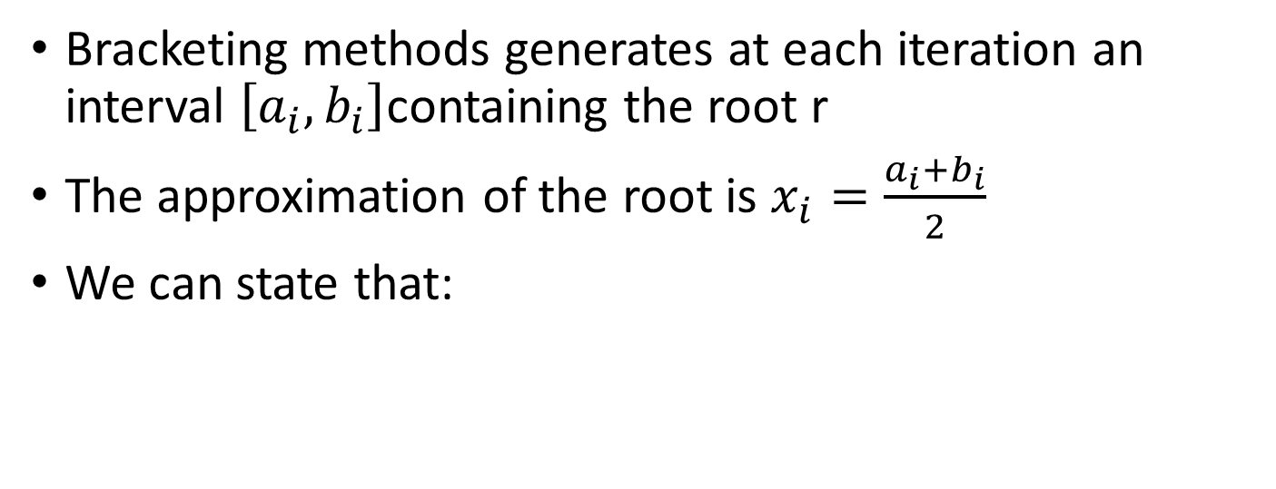
Estimating the error for bracketing methods
Bracketing methods generates at each iteration an interval $\left[a_{i},b_{i}\right]$containing the root r
The approximation of the root is $x_{i}=\frac{a_{i}+b_{i}}{2}$
We can state that:
x_{i}
$$\left|x_{i}−r\right|≤\left|\frac{b_{i}−a_{i}}{2}\right|$$
Error $≤\left|\frac{b_{i}−a_{i}}{2}\right|$
$$a_{i}$$
$$x_{i}$$
$$r$$
$$b_{i}$$
Notes:
For bracketing methods we learned that the error can be estimated in a very save way: it is never larger than half of the length of the interval bracketing the root.
Whenever this method can be used to estimate the error it should be used.

Slide 10
Estimating the error for open methods
We estimate the error $E_{i}$ in iteration $i$ by comparing the answer with the previous iteration:
If we are interested in the relative error $e_{i}$ we use:
x_{i}
$$E_{i}≅\left|x_{i}−x_{i−1}\right|$$
$$e_{i}≅\left|\frac{x_{i}−x_{i−1}}{x_{i}}\right|$$
Notes:
For open methods we no longer had a save way to estimate the error
We used a rough estimate by comparing the previous and current approximation computed by the algorithm
We learned however that this method is not always very accurate and can sometimes give much to optimistic error estimates. In such cases we totally underestimate the error which is obviously highly undesired.
For that reason we looked for better ways to estimate the errors.

Slide 11





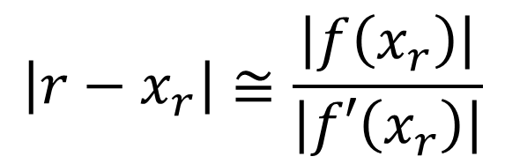


Forward Error Estimation
$$y$$
$$y=f(x)$$
$$f\left(x_{r} \right)$$
$$\left|r−x_{r}\right|≅\frac{\left|f\left(x_{r}\right)\right|}{\left|f′\left(x_{r}\right)\right|}$$
$$f′\left(x_{r} \right)$$
Backward Error
$$r$$
$$x_{r}$$
$$x$$
Forward Error
Notes:
Such a better way is based on the understanding of the concepts of forward and backward errors.
We learned how to estimate the forward error, the difference between the true root and the approximated solution, based on the backward error, the error we get when we plug back the approximated solution into the original root finding problem.
We learned as well that this method will fail if the function is flat around the root, which is the case for roots with high multiplicity (higher than one).

Slide 12
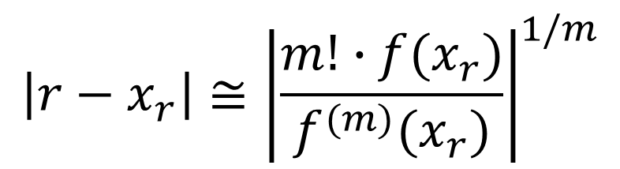



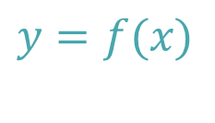
Forward error estimation for high multiplicity roots
$$y$$
$$y=f(x)$$
$$\left|r−x_{r}\right|≅{\left|\frac{m!∙f(x_{r})}{f^{(m)}(x_{r})}\right|}^{1/m}$$
$$r$$
$$x_{r}$$
Backward Error ≈ 0
$$x$$
Forward Error
Notes:
In the case of root with multiplicity m, we improved our error estimation formula in order to take into account the issue of the flatness of the function.
Note that this relation is the same as the one on the previous slide for the case of single roots where m=1.

